Slide 1
2023-24 OBOB titles for grades 9-12
Sponsored by the Oregon Association of School LIbraries

Slide 2
The City Beautiful by Adan Polydoros
In 1893 Chicago, after a friend becomes a victim in a line of murdered Jewish boys, Alter Rosen is thrown into the arms of a dangerous boy from his past.

Slide 3
The Cruel Prince by Holly Black
Jude, seventeen and mortal, gets tangled in palace intrigues while trying to win a place in the treacherous High Court of Faerie, where she and her sisters have lived for a decade.

Slide 4
The Final Six by Alexandra Monir
Naomi, an Iranian-American science genius is surrounded by strangers all competing for one of the six slots to travel to Jupiter's moon. She finds a friend in Leo, an Italian championship swimmer, as the training tests their limits.

Slide 5
Firekeeper’s Daughter by Angeline Boulley
Daunis, who is part Ojibwe, defers attending the University of Michigan to care for her mother, and becomes involved in the investigation of drug-related deaths.

Slide 6
The Fountains of Silence by Ruta Sepetys
At the Castellana Hilton in 1957 Madrid, eighteen-year-old Daniel Matheson connects with Ana Moreno through photography and fate as Daniel discovers the incredibly dark side of the city under Generalissimo Franco's rule.

Slide 7
Furia by Yamile Saied Méndez
Seventeen-year-old Camila Hassan, a rising soccer star in Rosario, Argentina, dreams of playing professionally, in defiance of her father and risking her romance with Diego.

Slide 8
Gone to the Woods: Surviving a Lost Childhood by Gary Paulsen
His name is synonymous with high-stakes wilderness survival stories. Now, author Gary Paulsen portrays a series of life-altering moments from his turbulent childhood as his own original survival story.

Slide 9
House of Hollow by Krystal Sutherland
When their older sister Grey goes missing, Iris and Vivi work to uncover their dark, dangerous, and possibly magical past.

Slide 10
Northanger Abbey by Jane Austen
Young Catherine Morland, the heroine of Northanger Abbey, has a vivid imagination which thrives on mysterious strangers and haunted ruins. When she meets the handsome Henry Tilney, her fantasies lead her into disastrous errors of judgement.

Slide 11
Today, Tonight, Tomorrow by Rachel Lynn Solomon
Rowan and Neil compete with one another on everything from who has the best ideas for school functions to which will be the valedictorian. They learn they share something much deeper than a rivalry.

Slide 12
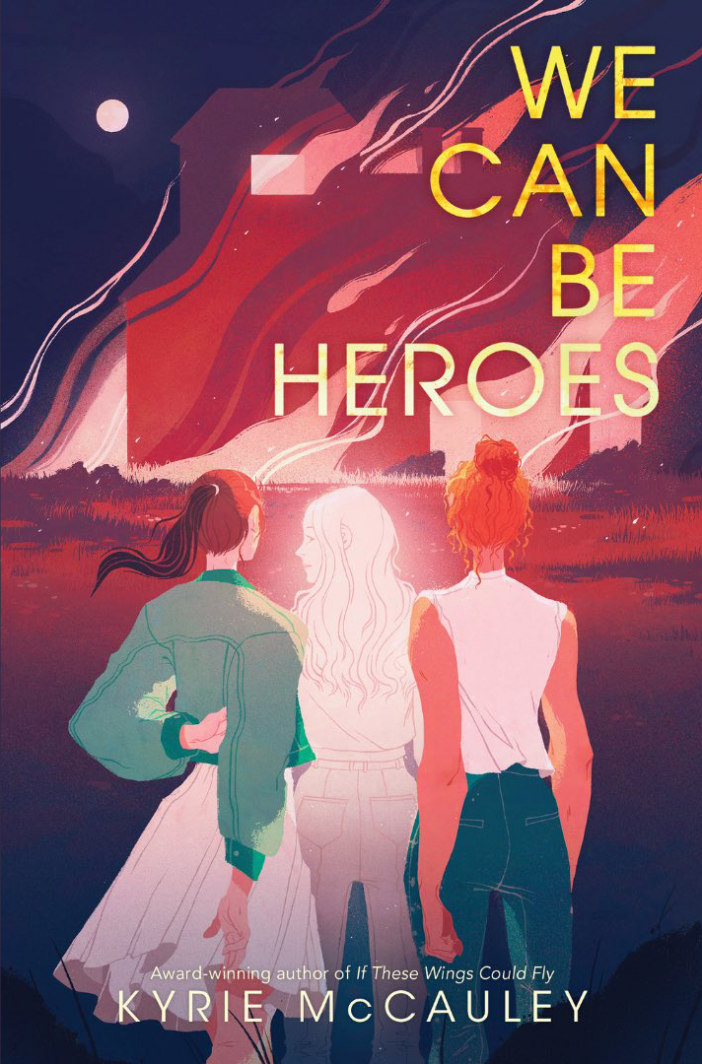
We Can be Heroes by Kyrie McCauley
Beck and Vivian never could stand each other, but they always tried their best for their mutual friend, Cassie. After the town moves on from Cassie’s murder too fast, Beck and Vivian finally find common ground: vengeance.

Slide 13
The Weight of Our Sky by Hanna Alkaf
Amid the Chinese-Malay conflict in Kuala Lumpur in 1969, sixteen-year-old Melati must overcome prejudice, violence, and her own OCD to find her way back to her mother.

