Slide 1
2023-24 OBOB titles for grades 6-8
Sponsored by the Oregon Association of School LIbraries

Slide 2
Barefoot Dreams of Petra Luna by Alda P. Dobbs
Based on a true story, the tale of one girl's perilous journey to cross the U.S. border and lead her family to safety during the Mexican Revolution.

Slide 3
The Benefits of Being an Octopus by Ann Braden
Seventh-grader Zoey Albro focuses on caring for three younger siblings and avoiding rich classmates at school until her fascination with octopuses gets her on the debate team, and she begins to speak out.

Slide 4
The Blackbird Girls by Anne Blankman
When Valentina awakes to a red sky marred by billowing blue smoke, she knows something has gone wrong in her home of Pripyat, Ukraine. Her worry only grows when her father doesn’t return from his shift at the Chernobyl power station.

Slide 5
The Boys in the Back Row by Mike Jung
Matt and Eric are planning one big final adventure filled with hilarious hijinks and geekiness galore before Eric moves away.

Slide 6
Focused by Alyson Gerber
Twelve-year-old Clea wants to do her homework, follow instructions, pay attention in school, and play chess on the school team, but somehow she cannot focus on whatever is in front of her.

Slide 7
The Girl and the Ghost by Hanna Alkaf
A lonely girl, Suraya, inherits from her grandmother a pelesit, a ghostly demon, who proves to be a good companion, bringing both danger and hope.

Slide 8
A High Five for Glenn Burke by Phil Bildner
After researching Glenn Burke, the first major league baseball player to come out as gay, sixth-grader Silas Wade slowly comes out to his best friend, Zoey, and then his coach, with unexpected consequences.

Slide 9
The Hobbit, or There and Back Again by J. R. R. Tolkein
Bilbo Baggins, a respectable, well-to-do hobbit, lives comfortably in his hobbit-hole until the day the wandering wizard Gandalf chooses him to take part in an adventure from which he may never return.

Slide 10
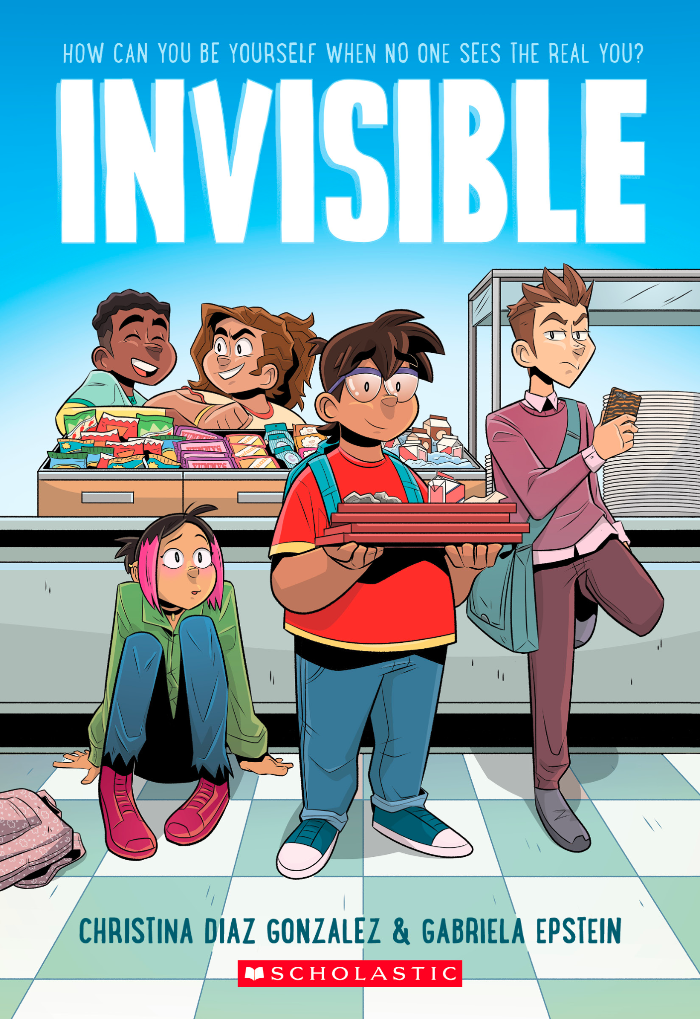
Invisible by Christina Diaz Gonzalez and Gabriela Espstein
This book tells a story about five very different students who are forced together by their school to complete community service... and may just have more in common than they thought.

Slide 11
Katie the Catsitter by Colleen AF Venable and Stephanie Yue
Twelve-year-old Katie is dreading the boring summer ahead, but then she gets a job catsitting for her mysterious upstairs neighbor and life gets interesting.

Slide 12
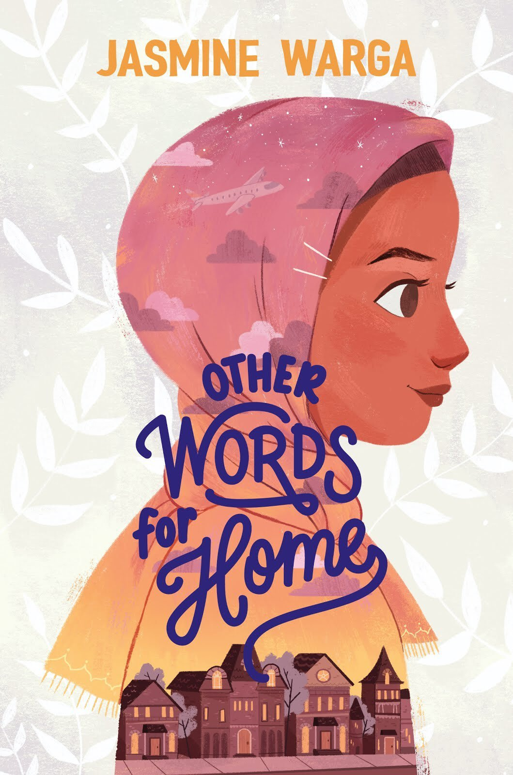
Other Words for Home by Jasmine Warga
Jude is sent with her mother to the safety of a relative's home in Ohio when their Syrian hometown is overshadowed by violence. Jude adjusts to a new life with unexpected surprises.

Slide 13
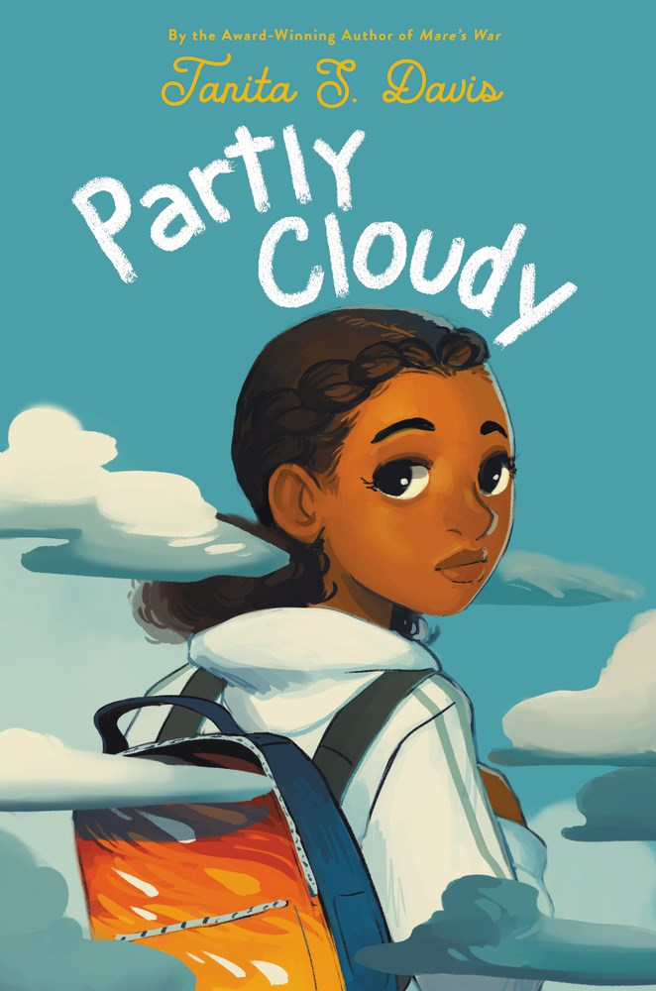
Partly Cloudy by Tanita S. Davis
In desperate need of clear skies as she starts a new school, Madalyn has days filled with clouds that lead to serious storms until she learns the power of community and family after disaster strikes.

Slide 14
Powerless by Matthew Cody
Soon after moving to Noble's Green, Pennsylvania, twelve-year-old Daniel learns his new friends have super powers that they will lose when they turn thirteen, unless he can use his brain power to protect them.

Slide 15
Stowaway by John David Anderson
Scientists discover a rare and mysterious mineral buried in Earth's crust, which happens to be the most valuable substance in the entire universe. Leo‘s father decides it would be best for them to leave Earth behind. Then their ship is attacked, Leo’s father is kidnapped, and Leo and his brother are stranded in the middle of space. The only chance they have is for Leo to stow away on a ship of space pirates.

Slide 16
Wink by Rob Harrell
After being diagnosed with a rare eye cancer, twelve-year-old Ross discovers how music, art, and true friends can help him survive both treatment and middle school.

Slide 17
Yusuf Azeem is Not a Hero by Saadia Faruqi
Yusuf is excited to start middle school in his small Texas town, but with the twentieth anniversary of the 9/11 attacks coming up, it feels like the country's anger and grief is focused on his Muslim community.

