Slide 1
2023-24 OBOB titles for grades 3-5
Sponsored by the Oregon Association of School LIbraries

Slide 2
Allergic by Megan Wagner Lloyd
Hoping to adopt a pet to find a sense of belonging in her busy family, Maggie is disappointed to discover she is severely allergic to anything with fur and tries to find a pet to love anyway.

Slide 3
Flor and Miranda Steal the Show by Jennifer Torres
Enjoy carnival rides and deep fried pickles in this warm, funny middle grade novel about family and friendship.

Slide 4
From the Mixed-Up Files of Mrs. Basil E. Frankweiler by E. L. Konigsburg
Claudia and her brother Jamie run away from home and take up residence in the Metropolitan Museum of Art.

Slide 5
The Jumbies by Tracey Baptiste
Eleven-year-old Corinne must call on her courage and ancient magic to stop an evil spirit and save her island home.

Slide 6
The List of Things that Will Not Change by Rebecca Stead
Despite her parents' divorce, her father's coming out as gay, and his plans to marry his boyfriend, ten-year-old Bea is reassured by her parents' unconditional love, excited about getting a stepsister, and haunted by something she did last summer.

Slide 7
The Lion of Mars by Jennifer L. Holm
Bell has spent his whole life, all eleven years of it, on Mars. But he's still just a regular kid who loves cats, any kind of cake, and is curious about the secrets the adults in the US colony are keeping.

Slide 8
The Midnight Children by Dan Gemeinhart
When lonely Ravani Foster discovers his new friend Virginia and her six mysterious runaway companions are in danger, he must fight to keep them safe or lose the only person who has ever understood him.

Slide 9
Molly and the Twin Towers: A 9/11 Survival Story by Jessika Fleck
When the Twin Towers fall on September 11, 2001, twelve-year-old Molly is unable to reach her dads or Gran. She must get herself and her sister safely home.

Slide 10
New From Here by Kelly Yang
Knox works to keep his family together as they move from Hong Kong back to northern California during the initial outbreak of a pandemic.

Slide 11
Rez Dogs by Joseph Bruchac
When the COVID-19 pandemic starts, Malian, a young Wabanaki girl, is quarantined with her grandparents on the reservation, where she befriends a local dog and learns about her people's history

Slide 12
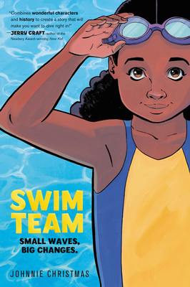
Swim Team by Johnny Christmas
Bree can't wait for her first day at her new middle school, Enith Brigitha, home to the Mighty Manatees--until she's stuck with the only elective that fits her schedule, the dreaded Swim 101.

Slide 13
The Trouble with Chickens by Doreen Cronin
A hard-bitten former search-and-rescue dog helps solve a complicated missing chicken case.

Slide 14
A True Home by Kallie George
When Mona the Mouse stumbles across the wondrous world of the Heartwood Hotel in the middle of a storm, she desperately hopes they'll let her stay.

Slide 15
Ways to Make Sunshine by Renée Watson
The Hart family of Portland, Oregon, faces many setbacks after Ryan's father loses his job. No matter what, Ryan tries to bring sunshine to her loved ones.

Slide 16
When You Trap a Tiger by Tae Keller
When Lily and her family move in with her sick grandmother, a magical tiger straight out of her halmoni's Korean folktales arrives, prompting Lily to unravel a secret family history.

Slide 17
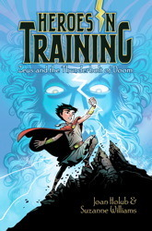
Zeus and the Thunderbolt of Doom* by Joan Holub and Suzanne Williams
After pulling a magical thunderbolt from a stone, ten-year-old Zeus goes on the adventure of a lifetime
*not the graphic novel version!

