Slide 1
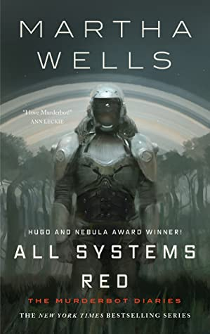
All Systems Red by Martha Wells
On a distant planet, a team of scientists are conducting surface tests, shadowed by their self-aware SecUnit that has hacked its own governor module, and refers to itself as “Murderbot.” When a neighboring mission goes dark, it's up to the scientists and their Murderbot to get to the truth.

Slide 2
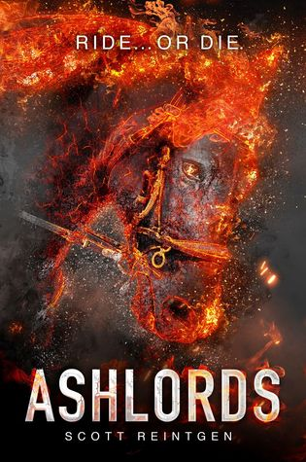
Ashlords by Scott Reintgen
This book follows alchemists Imelda, Adrian, and Pippa as they reach for their dreams of glory riding phoenix horses at The Races, the modern spectacle that has replaced warfare within their empire.

Slide 3
A Boy and his Dog at the End of the World by C. A. Fletcher
When a beloved family dog is stolen, her owner sets out on a life-changing journey through the ruins of our world to bring her back.

Slide 4
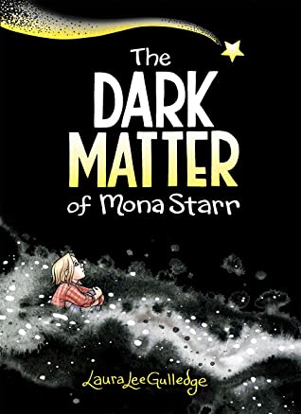
The Dark Matter of Mona Starr by Laura Lee Gulledge
Mona’s struggle with depression takes on a vivid, concrete form. Mona calls it her Matter. The Matter gets everywhere, telling Mona she’s not good enough. But through therapy, art, writing, and the persistence of a few good friends, Mona starts to understand her Matter, and how she can turn her fears into strengths.

Slide 5
A Good Girl’s Guide to Murder by Holly Jackson
As her senior capstone project, Pippa Fitz-Amobi is determined to find the real killer in a closed local murder case, but not everyone wants her meddling in the past.

Slide 6
I Love You so Mochi by Sarah Kuhn
Kimi Nakamura loves fashion and designing clothes, jewelry, and accessories for her friends. Her mother calls that a hobby. Kimi tries to figure out what she wants when she visits her grandparents in Japan.

Slide 7
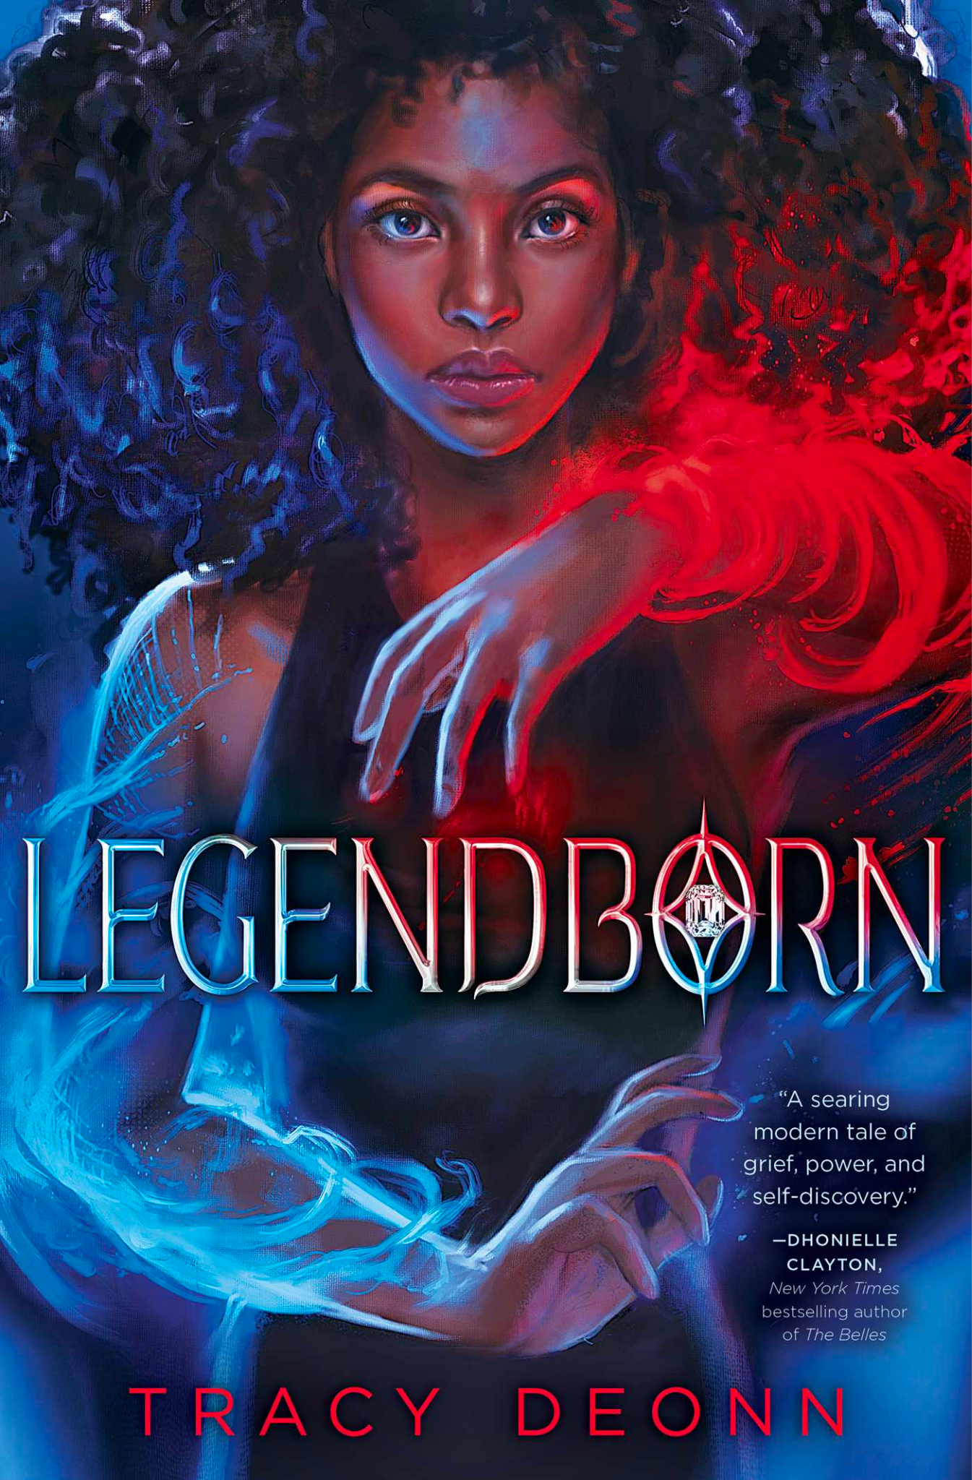
Legendborn by Tracy Deonn
To learn more about her mysterious past, a teen girl infiltrates a magical secret society claiming to be the descendants of King Arthur and his knights.

Slide 8
Not So Pure and Simple by Lamar Giles
High school junior Del Rainey unwittingly joins a Purity Pledge class at church, hoping to get closer to his long-term crush, Kiera.

Slide 9
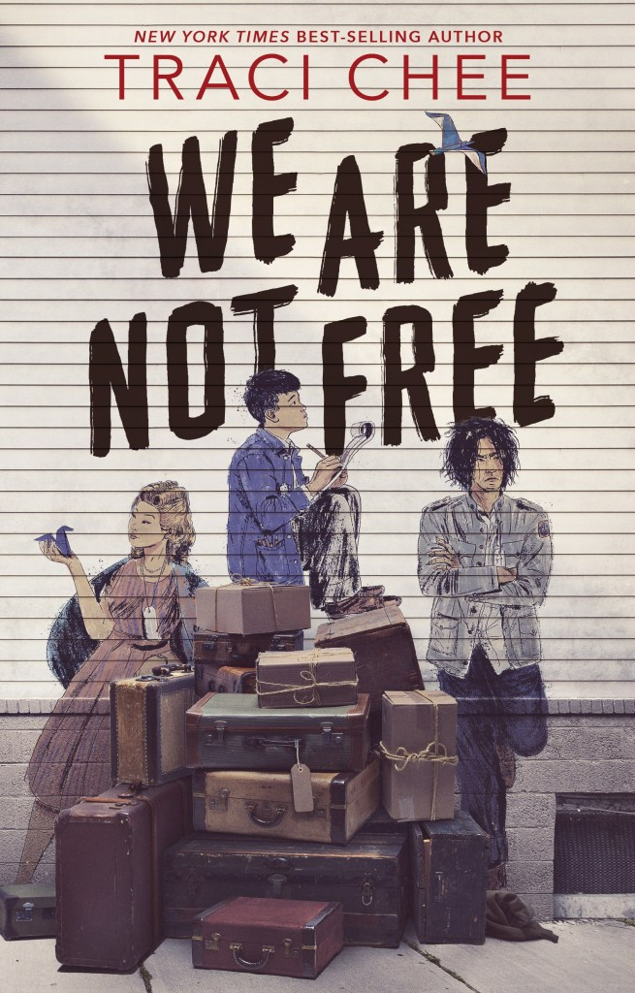
We Are Not Free by Traci Chee
A tightknit group of teens who grew up together in Japantown, San Francisco, have their lives turned upside down when they are forced into incarceration camps during WWII.

Slide 10
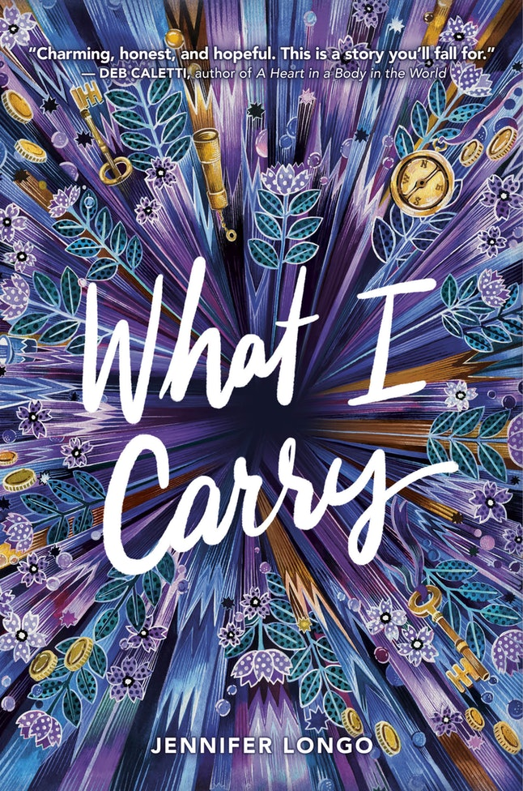
What I Carry by Jennifer Longo
In her final year in foster care, seventeen-year-old Muir tries to survive her senior year before aging out of the system.

Slide 11
With the Fire on High by Elizabeth Acevedo
Teen mother Emoni Santiago struggles with the challenges of finishing high school and achieving her dream of working as a chef.

Slide 12
You Should See Me in a Crown by Leah Johnson
Liz Lighty has always avoided the spotlight in her small, wealthy, and prom-obsessed midwestern high school. She concentrates on grades and music–until circumstances force a change in plans. .

