Slide 1
Amari and the Night Brothers by B. B. Alston
Thirteen-year-old Amari, a poor African American girl from the projects, gets an invitation from her missing brother to join the Bureau of Supernatural Affairs and join in the fight against an evil magician.

Slide 2
The Barren Grounds by David A. Robertson
Morgan and Eli are Indigenous children who've been brought together in a foster home in Winnipeg, Manitoba. After entering a portal to another reality, they find ways to connect with their culture and each other.

Slide 3
Blended by Sharon M. Draper
Eleven-year-old Isabella feels like a push-me-pull-me toy after her parents' divorce. People's comments about her mixed race leave Isabella unsure about her identity. If she is only seen as half of this and half of that, how can she ever feel whole?

Slide 4
Brown Girl Dreaming by Jacqueline Woodson
Raised in South Carolina and New York, author Jacqueline Woodson always felt halfway home in each place. Through vivid free verse, she shares what it was like to grow up as an African American in the 1960s and 1970s.

Slide 5
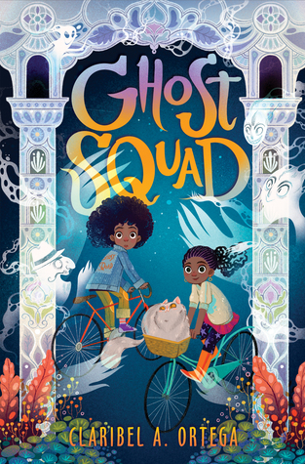
Ghost Squad by Claribel A. Ortega
Shortly before Halloween, Lucely and her best friend, Syd, cast a spell that accidentally awakens malicious spirits, wreaking havoc throughout St. Augustine.

Slide 6
The Girl from the Sea by Molly Knox Ostertag
When fifteen-year-old Morgan falls into the sea, she is saved from drowning by a mysterious girl named Keltie. As the two become friends, they learn they both have secrets.

Slide 7
Girl in the Blue Coat by Monica Hesse
In 1943 Nazi-occupied Amsterdam, teenage Hanneke, a "finder'" of black market goods, is tasked with finding a Jewish girl who a customer had been hiding and has seemingly vanished into thin air

Slide 8
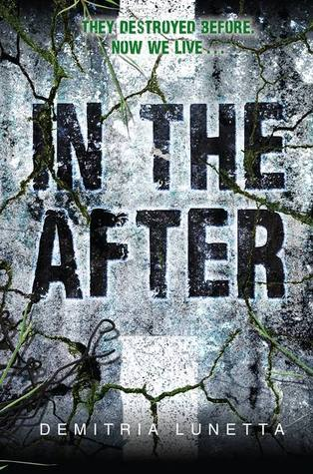
In the After by Demitria Lunetta
In a post-apocalyptic world in which nothing is as it seems, sixteen-year-old Amy and Baby, a child she found while scavenging, struggle to survive while vicious, predatory creatures roam Earth.

Slide 9
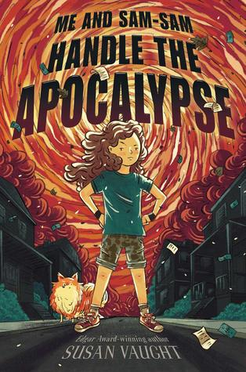
Me and Sam-Sam Handle the Apocalypse by Susan Vaught
Jesse is on the case when money goes missing from the library and her dad looks like the number one suspect.

Slide 10
Slider by Peter Hautman
David can eat a sixteen-inch pepperoni pizza in four minutes and thirty-six seconds. Not bad, but he knows he can do better. In fact, he will have to do better. He is going to compete in the Super Pigorino Bowl, the world's greatest pizza-eating contest.

Slide 11
Taylor Before and After by Jennie Englund
Taylor recounts in journal entries two timelines--before and after a tragic accident, the decimation of her social life, being bullied by her former best friend, and the irrevocable change of her home.

Slide 12
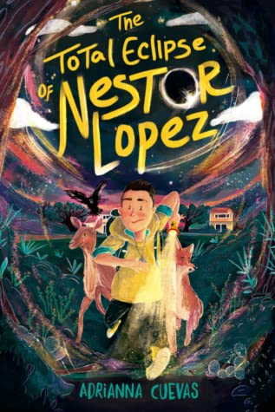
The Total Eclipse of Nestor Lopez by Adrianna Cuevas
A Cuban-American boy must use his ability to communicate with animals to save the inhabitants of his town when they are threatened by a witch that transforms into animals.

Slide 13
Tristan Strong Punches a Hole in the Sky by Kwame Mbalia
Seventh-grader Tristan Strong tumbles into the MidPass and, with allies John Henry and Brer Rabbit, must entice the god Anansi to come out of hiding and seal the hole Tristan accidentally ripped in the sky.

Slide 14
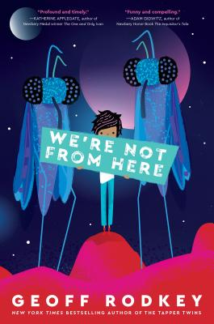
We’re Not From Here by Geoff Rodkey
After a year on Mars, Lan and Lan's family migrate to the planet Choom, but the inhabitants of Choom don't like humans. It's up to Lan's family to change the minds of Choom's inhabitants if humans hope to survive.

Slide 15
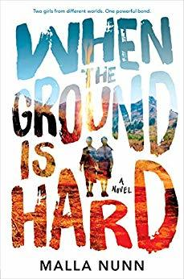
When the Ground is Hard by Malia Nunn
At Swaziland's Keziah Christian Academy, where the wealth and color of one's father determines one's station, once-popular Adele bonds with poor Lottie over a book and a series of disasters.

Slide 16
While I Was Away by Waka T. Brown
When Waka's mother suspects her twelve-year-old daughter can't understand basic Japanese, she makes a drastic decision to ship Waka to Tokyo to live with her strict grandmother to reconnect with the culture and master the language.

