Slide 1
The Best of Iggy by Annie Barrows
Nine-year-old Iggy gets into trouble three times, two of which he does not regret and one for which he is very, very sorry.

Slide 2
Letters from Cuba by Ruth Behar
In 1938, eleven-year-old Esther joins her father in tropical, multicultural Cuba, where they toil together to rescue the rest of their Jewish family from persecution in Poland.

Slide 3
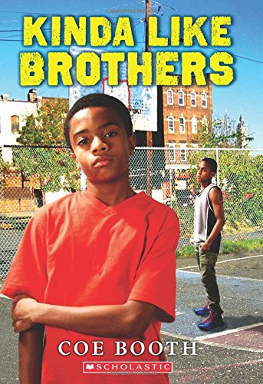
Kinda Like Brothers by Coe Booth
Jarrett is used to the foster babies his mother takes in, but he is not used to sharing a room with a foster kid, especially a secretive boy who's a year older than he is.

Slide 4
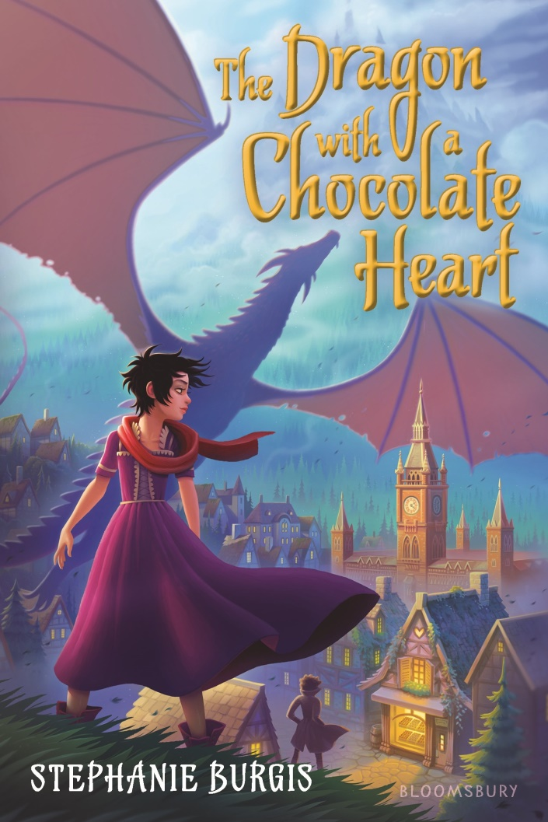
The Dragon with a Chocolate Heart by Stephanie Burgis
After drinking enchanted hot chocolate, a brave young dragon is transformed into a twelve-year-old human girl with a passion for chocolate.

Slide 5
Me, Frida, and the Secret of the Peacock Ring by Angela Cervantes
When Lizzie and Gael share an irresistible challenge, to find the peacock ring that once belonged to artist Frida Kahlo, Paloma decides it is the perfect way to honor her father.

Slide 6
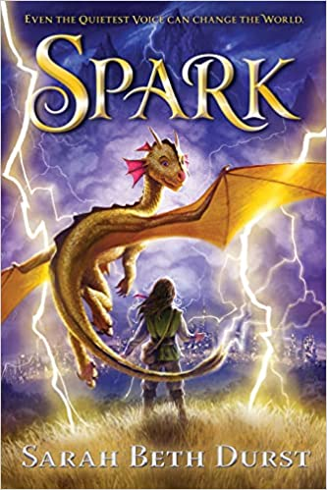
Spark by Sarah Beth Durst
Naturally quiet since birth, Mina and her storm beast, Pixit, lead others in defying authority and attempting to spread the truth that Alorria's idyllic weather comes at a steep cost.

Slide 7
Shirley and Jamila Save Their Summer by Gillian Goerz
When ten-year-olds Shirley and Jamila meet, Jamila is simply hoping for a friend in her new neighborhood but Shirley is a detective, and together they seek a missing gecko.

Slide 8
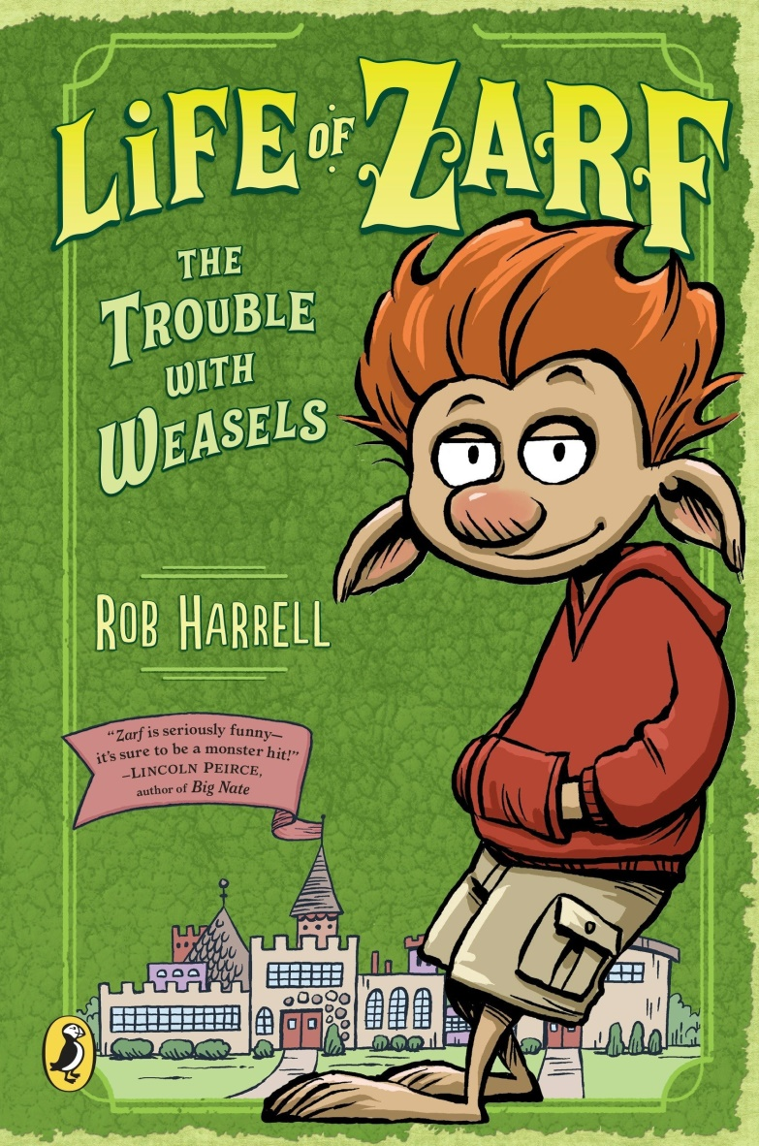
The Trouble with Weasels by Rob Harrell
As a troll, Zarf Belford is at the bottom of the social ladder at Cotswin Middle School, but when the king goes missing and his insufferable son takes control, Zarf leads his friends Kevin and Chester on a rescue mission.

Slide 9
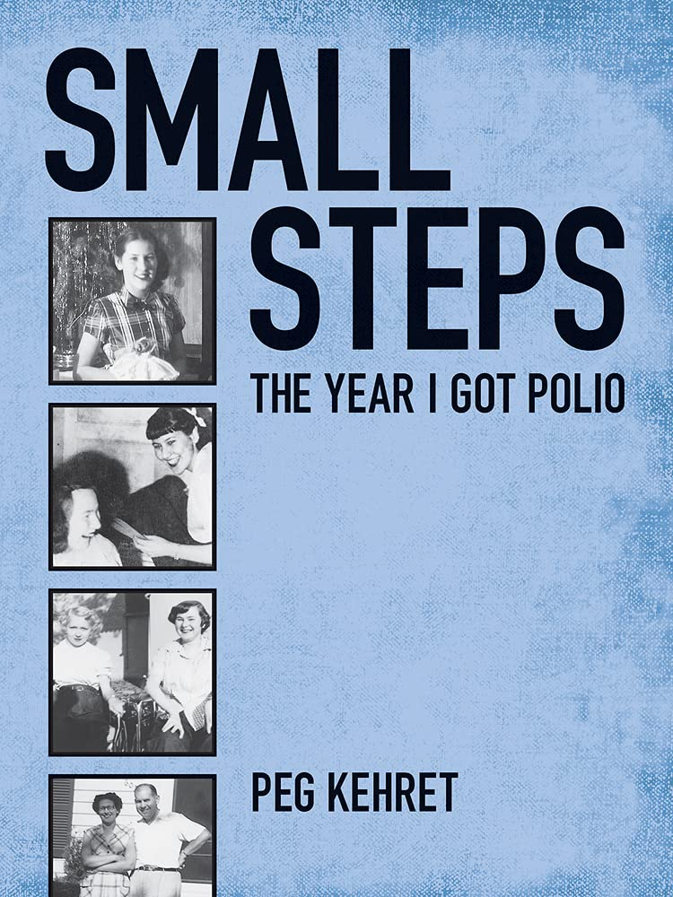
Small Steps: The Year I Got Polio by Peg Kehret
The author describes her battle against polio and her efforts to overcome its debilitating effects.

Slide 10
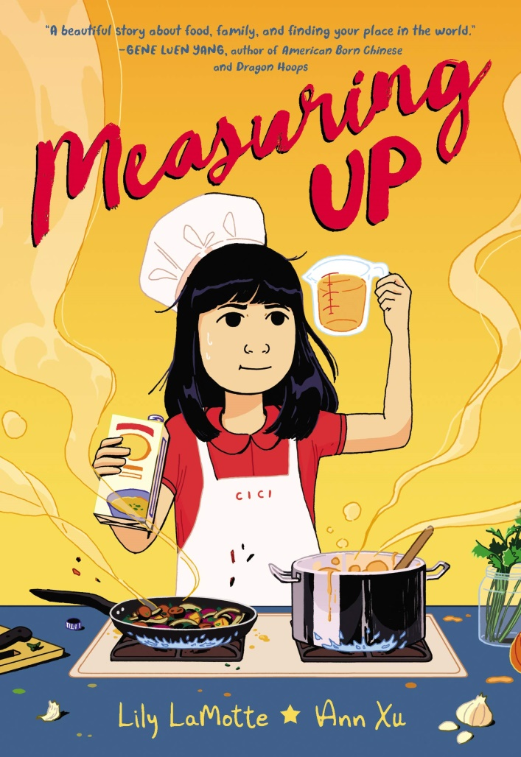
Measuring Up by Lily LaMotte & Ann Xu
Having just moved from Seattle to Taiwan, twelve-year-old Cici enters a cooking competition to win the chance to see her grandmother again, but she only knows how to cook Taiwanese food.

Slide 11
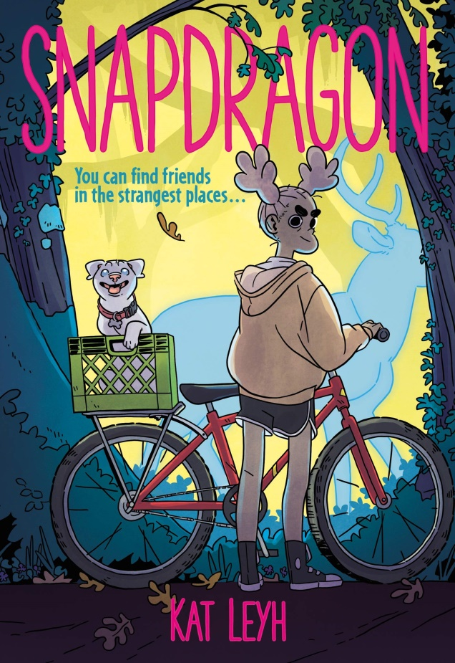
Snapdragon by Kat Leyhc
Snap's town has a witch and when Snap's dog goes missing, the first place she looks is the witch's house.

Slide 12
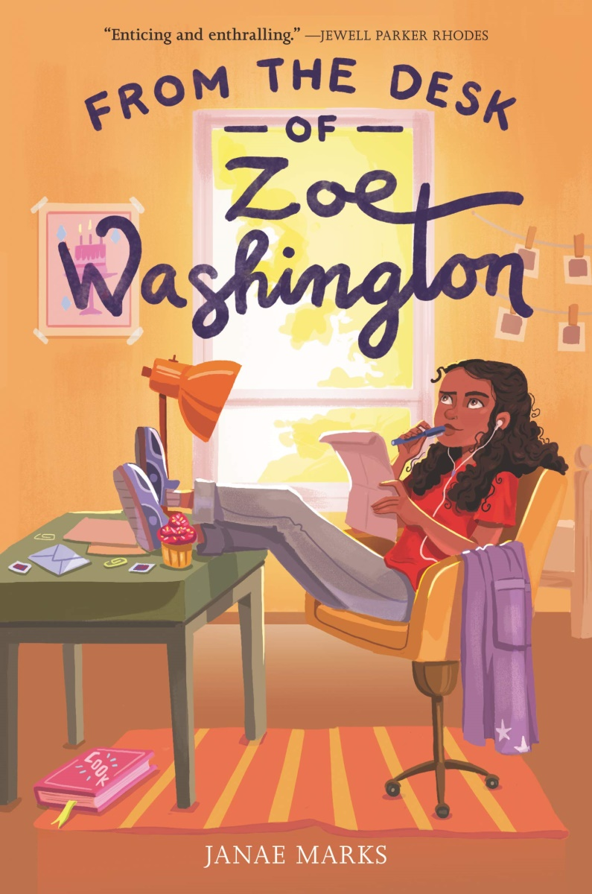
From the Desk of Zoe Washington by Janae Marks
Avid baker Zoe Washington receives a letter on her twelfth birthday from her biological father, who is in prison for a terrible crime.

Slide 13
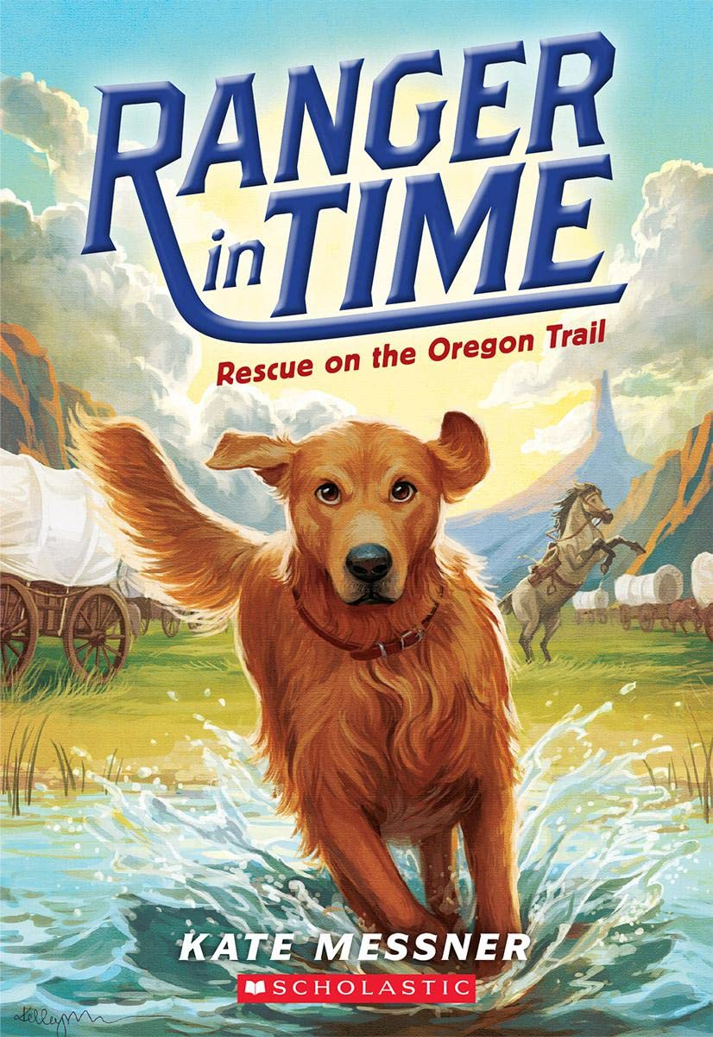
Rescue on the Oregon Trail by Kate Messner
Ranger, a golden retriever, could have been a great search-and-rescue dog, except for the squirrels. One day, he unearths a mysterious box and finds himself transported back to the year 1850, where his service is really needed.

Slide 14
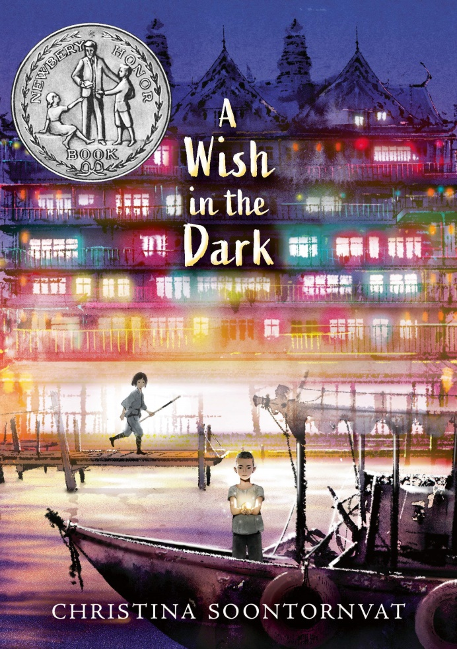
A Wish in the Dark by Christina Soontornvat
After escaping from prison, Pong hides out in a city run by a governor who magically controls all light. Nok, whose father oversaw the prison, vows to find Pong and restore her family's good name.

Slide 15
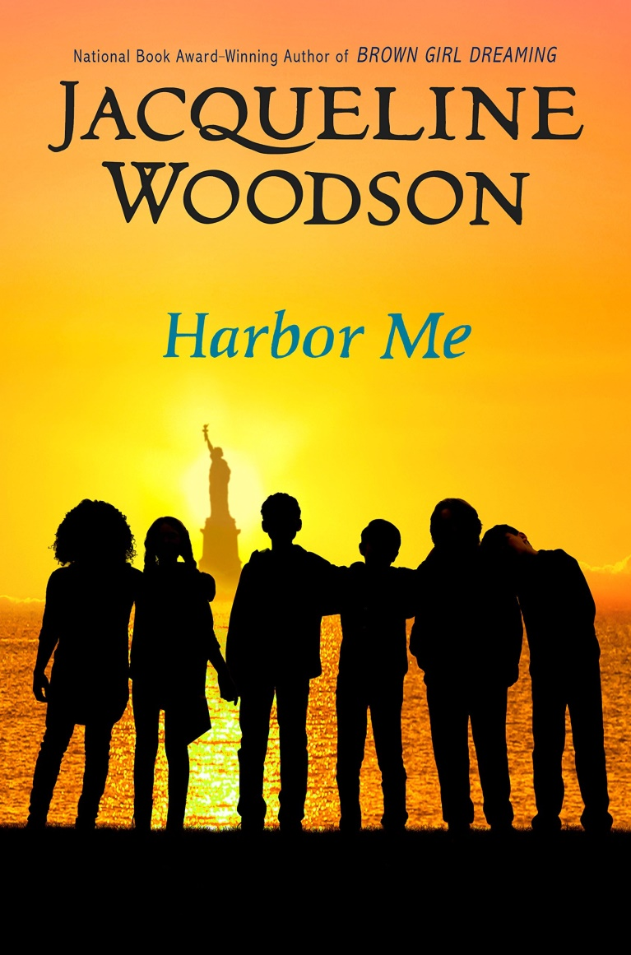
Harbor Me by Jacqueline Woodson
When six students are chosen to participate in a weekly talk with no adults allowed, they discover that when they're together, it's safe to share the hopes and fears they have to hide from the rest of the world.

