Slide 1
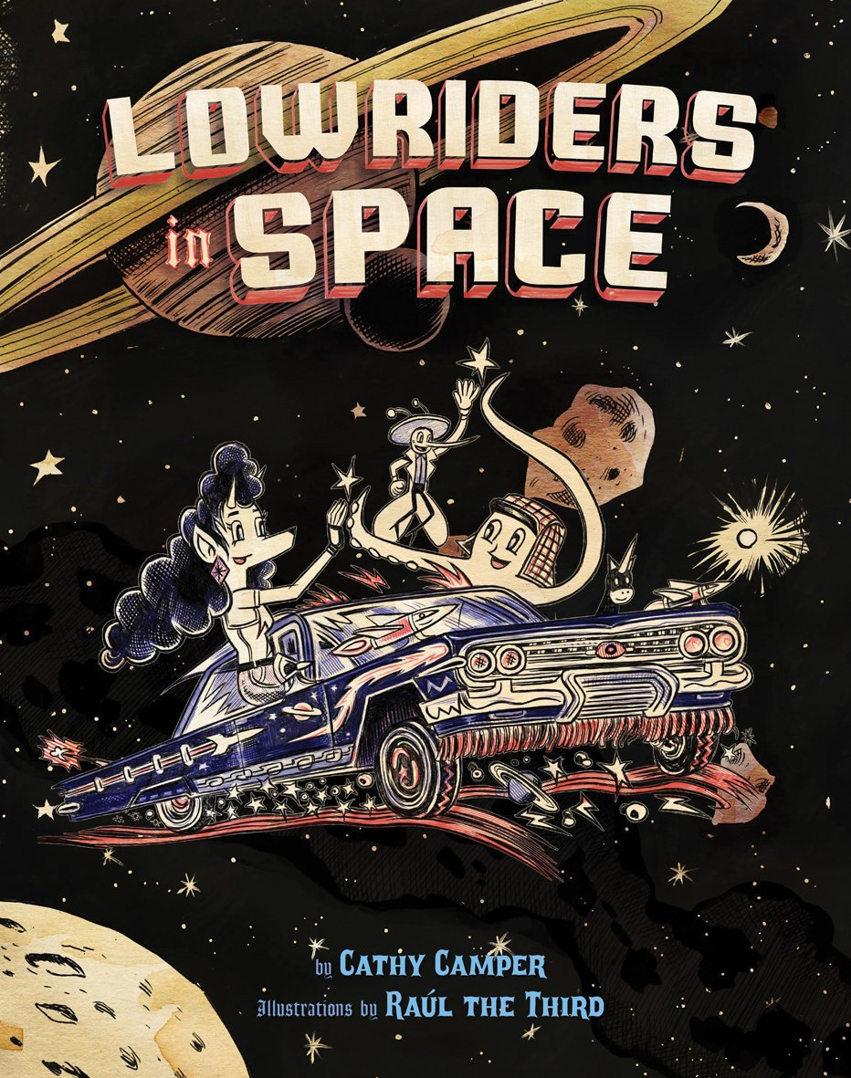
Lowriders in Space by Cathy Camper & Raúl the Third
Lupe, Flapjack, Elirio customize their car into a low rider for the Universal Car Competition to win the cash prize that will enable them to buy their own garage.

Slide 2
Lety Out Loud by Angela Cervantes
When Lety jumps at the chance to write animal profiles for the Furry Friends Animal Shelter, she is forced to team up with a grumpy classmate named Hunter, who devises a contest to decide who gets to be the official shelter scribe.

Slide 3
The Care and Feeding of a Pet Black Hole by Michelle Cuevas
Eleven-year-old Stella Rodriguez finds herself in possession of a strange new pet that swallows up everything in sight when a black hole decides to follow her home.

Slide 4
I Can Make This Promise by Christine Day
When twelve-year-old Edie finds letters and photographs in her attic that change everything she thought she knew about her Native American mother's adoption, she realizes she has a lot to learn about her family's history and her own identity.

Slide 5
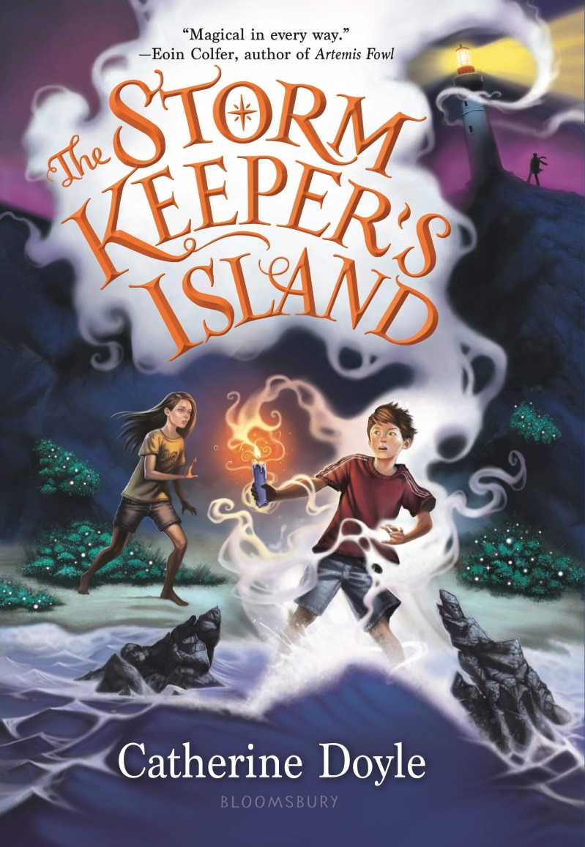
The Storm Keeper’s Island by Catherine Doyle
Fionn Boyle, terrified of the sea, must spend the summer with this older sister, Tara, and their grandfather on Arranmore, an island that has been known to make people disappear, and seems to be restless again.

Slide 6
The Fourteenth Goldfish by Jennifer L. Holm
Ellie's scientist grandfather has discovered a way to reverse aging, and consequently has turned into a teenager--which makes for complicated relationships when he moves in with Ellie and her mother, his daughter.

Slide 7
The Bookwanderers by Anna James
Eleven-year-old Tilly Pages, who has found comfort in her grandparents' bookshop since her mother's disappearance, now learns that she can bookwander into any stories, and decides to seek her mother.

Slide 8
Astrid the Unstoppable by Maria Parr
An adventurous young girl spends her days singing and sledding down the hillside of her Norwegian mountain village to visit her curmudgeonly septuagenarian godfather before befriending a new family and a mysterious woman with an unexpected identity.

Slide 9
Stay by Bobbie Pyron
When Piper and her family move into a homeless shelter in a new city, she misses her former life while also finding new friendships at Hope House, including a street dog named Baby, that Piper must protect from being taken away for good when Baby’s person goes missing.

Slide 10
Sarah Journeys West by Nikki Shannon Smith
In the midst of the California Gold Rush, twelve-year-old Sarah and her family are living in the North as free Black people. Seeking a better life, Sarah's parents decide they will venture west on the Oregon Trail. On the trail, Sarah and her family face all kinds of hardship, including racism, extreme weather, difficult terrain, and disease. But the journey will be worth it if they can find fortune in California. Will Sarah and her family endure the trail and make a new life out west?

Slide 11
Clean Getaway by Nic Stone
An 11-year-old boy confronts the realities of race relations, past and present, and the mysterious agenda of his unconventional grandmother during an unplanned spring break road trip through the once-segregated American South.

Slide 12
Some Writer!: The Story of E. B. White by Melissa Sweet
In this stunning, first-ever fully-illustrated biography of legendary author E.B. White, Sibert medalist and Caldecott Honor winner Melissa Sweet uses White's letters, photos, and mementos, as well as her original collaged art, to tell the true story of one of the most beloved authors of all time.

Slide 13
The Harlem Charade by Natasha Tarpley
Seventh-graders Jin, Alexandra, and Elvin come from very different backgrounds and circumstances, but they all live in Harlem, and when Elvin's grandfather is attacked they band together to find out who is responsible--and the search leads them to an enigmatic artist whose missing masterpieces are worth a fortune, and into conflict with an ambitious politician who wants to turn Harlem into an historic amusement park.

Slide 14
Guts by Raina Telgemeier
Developing a chronic upset stomach that she initially dismisses as a bug, young Raina discovers that her symptoms are related to her anxieties about school, food and changing friendships, in a story based on the Eisner Award-winning author's childhood.

Slide 15
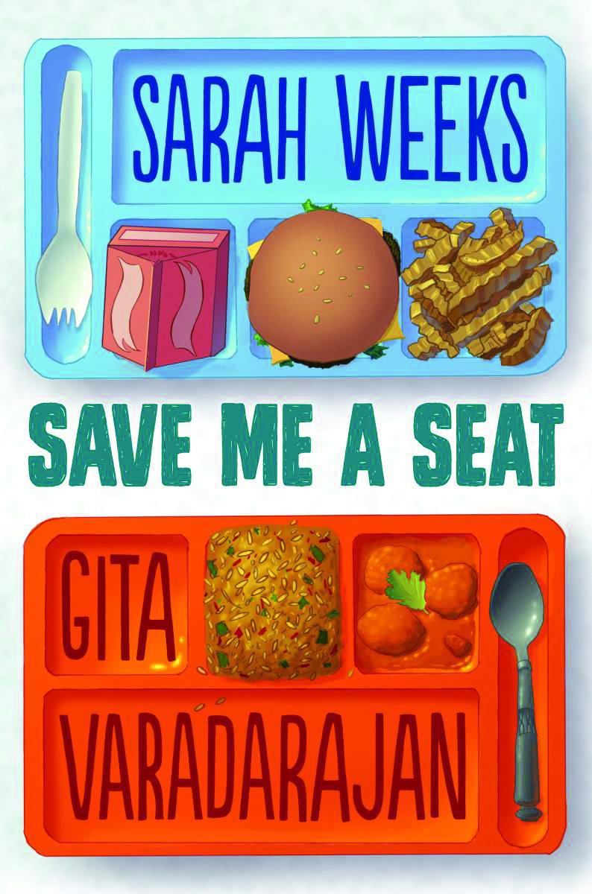
Save Me a Seat by Sarah Weeks & Gita Varadarajan
Ravi has just moved to the United States from India and has always been at the top of his class; Joe has lived in the same town his whole life and has learning problems--but when their lives intersect in the first week of fifth grade they are brought together by a common enemy (the biggest bully in their class) and the need to take control of their lives.

Slide 16
Some Places More Than Others by Renée Watson
Amara visits her father's family in Harlem for her twelfth birthday, hoping to better understand her family and herself, but New York City is not what she expected.

